Slide 1
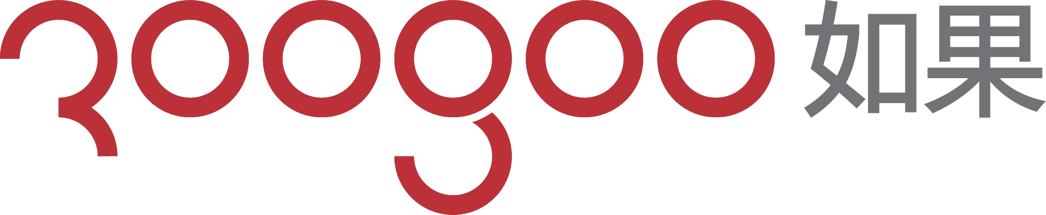
Manufacture the warm & original products

Slide 2
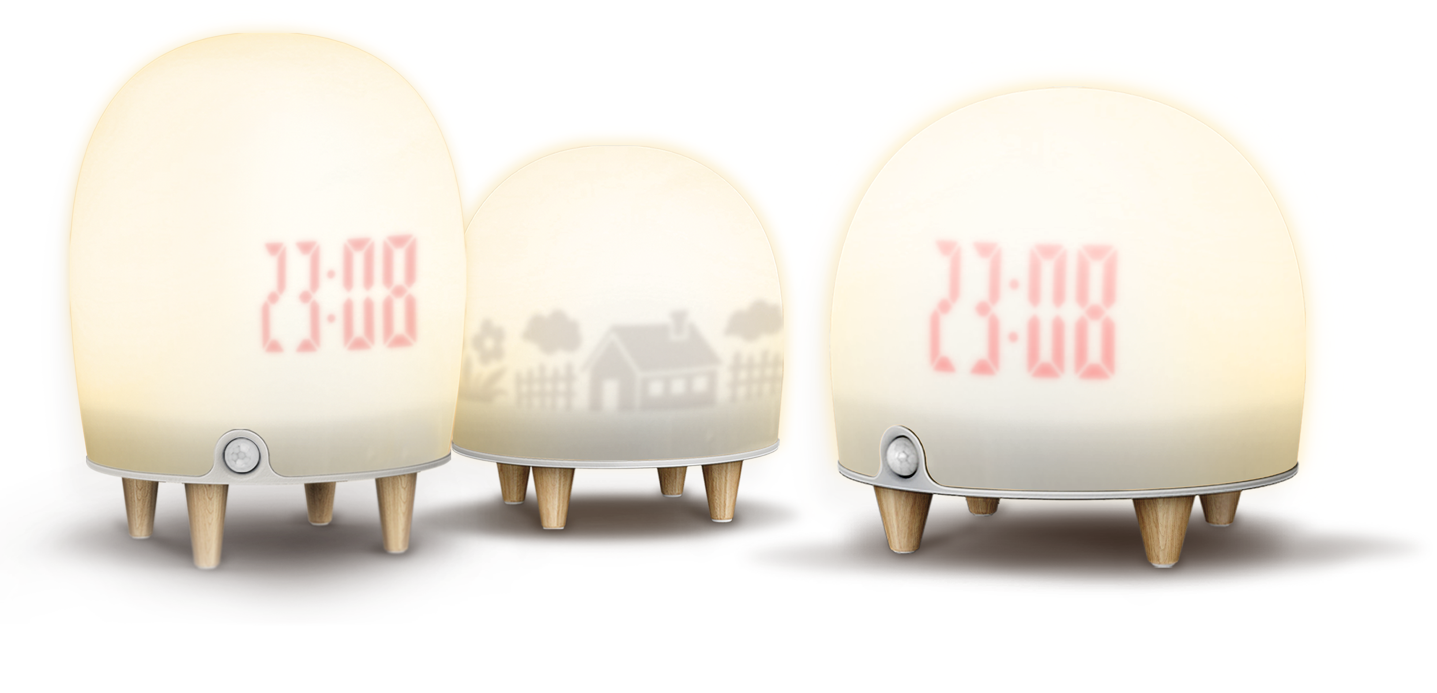
About us
Roogoo is a product development & manufacturing company in Guangdong, China.
Specialize in Creative Small Appliances such as Emotional lamp series, Makeup mirror series.
We have an award winning design team with 11 years of experience, winning rewards like the Red Dot&iF. Working with major brand names enables us to offer customized service for large scale companies. We want to deliver consistent success to our partners because we believe in what we’re doing.

Slide 3
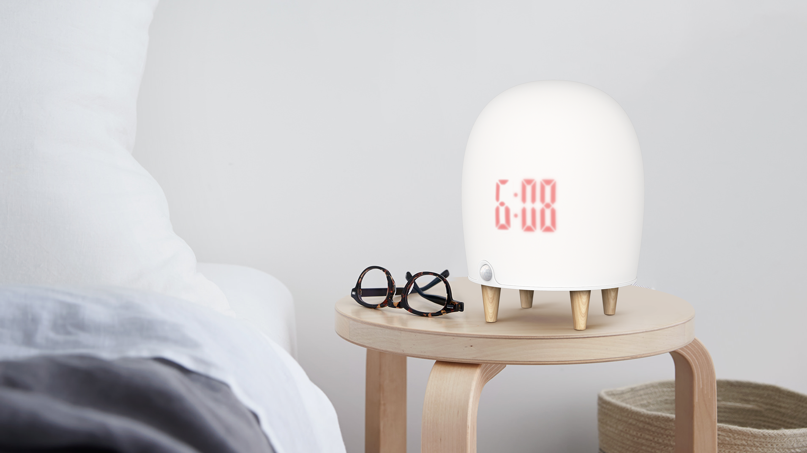
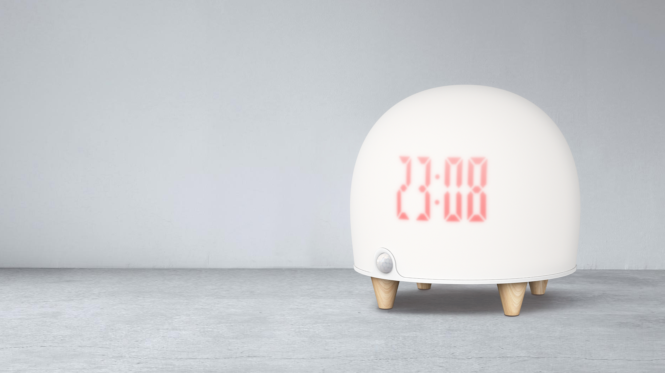
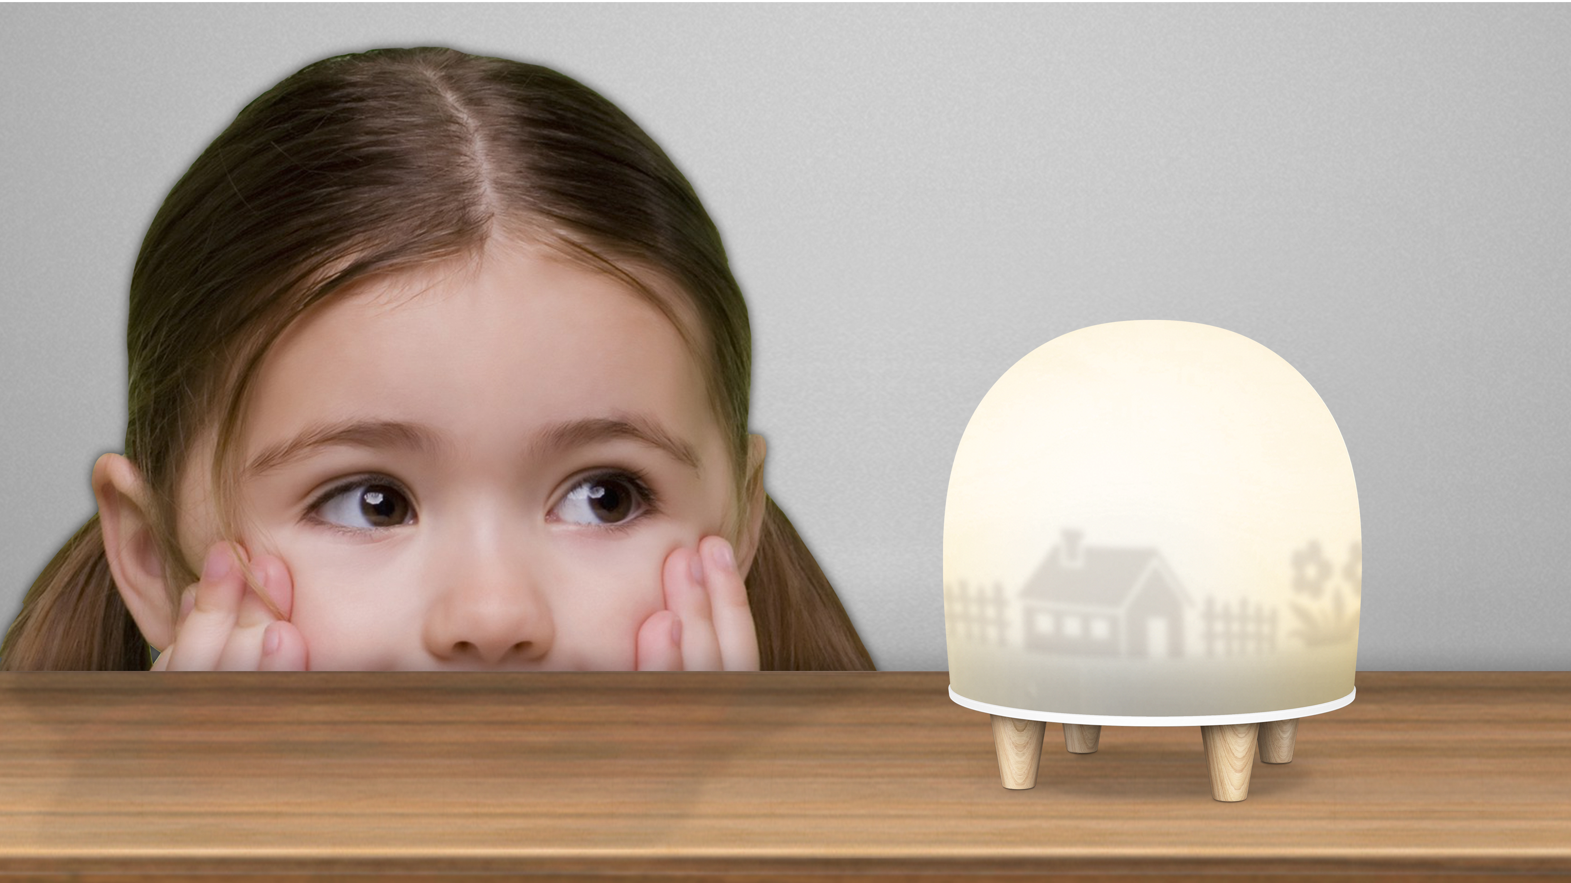
Product/service
1 Appearance patent, 3 Authorized Certification, 4 Innovative design, 6 Core Patents

Slide 4
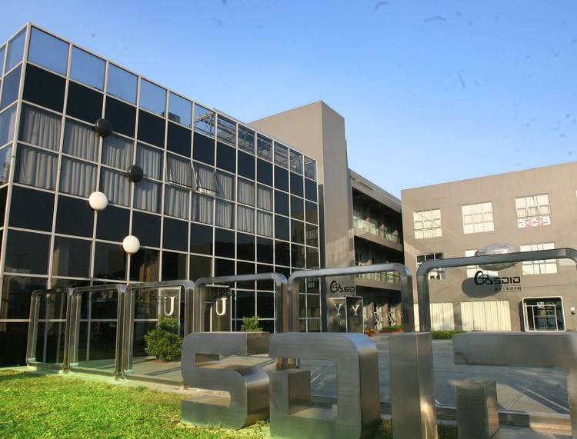
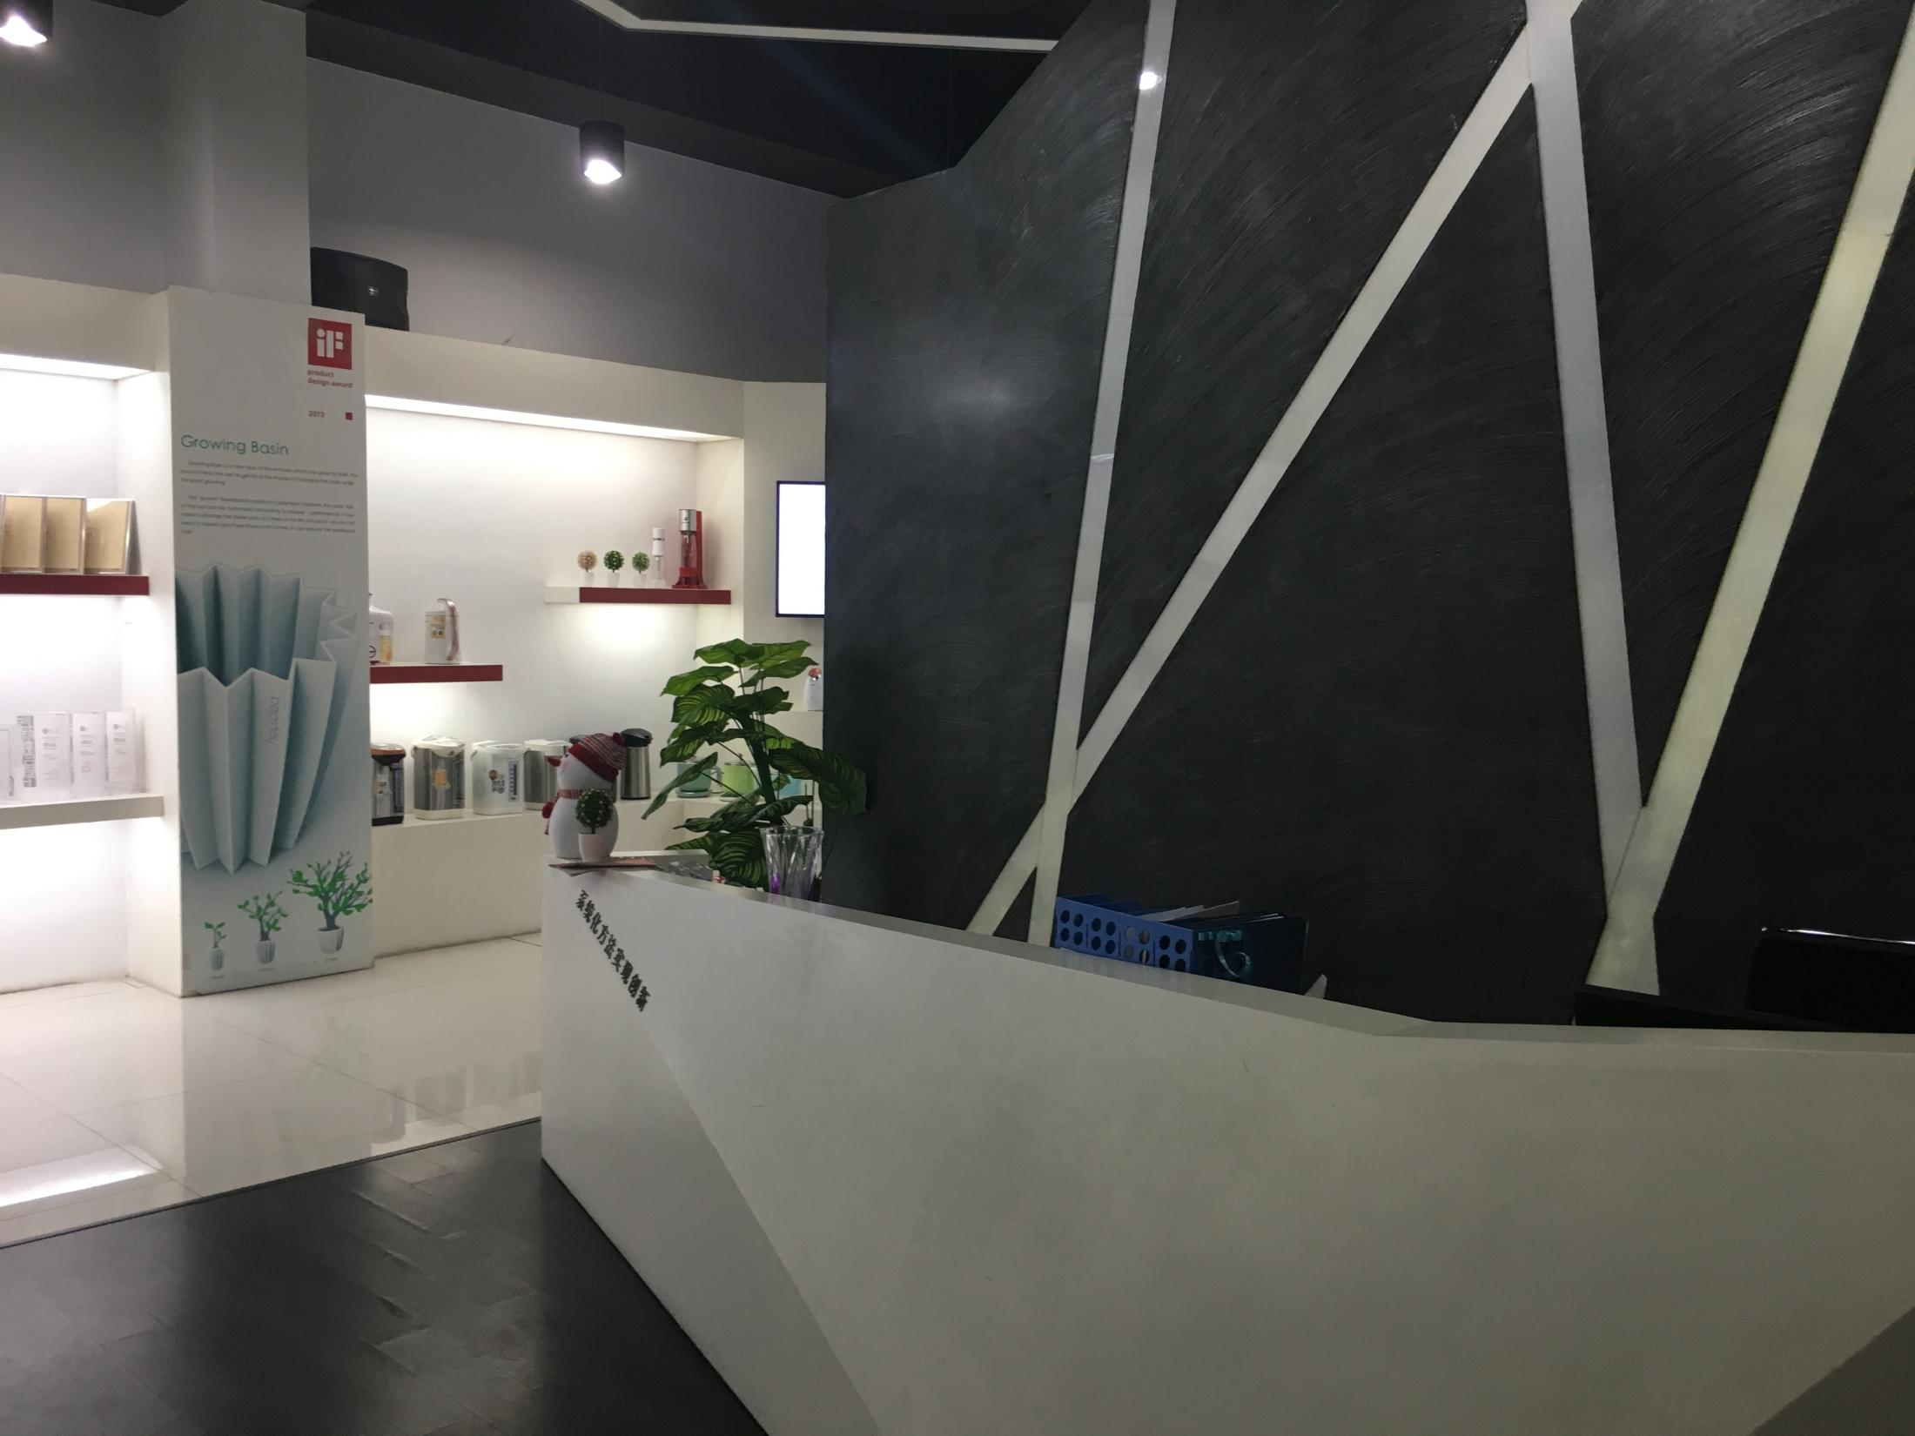
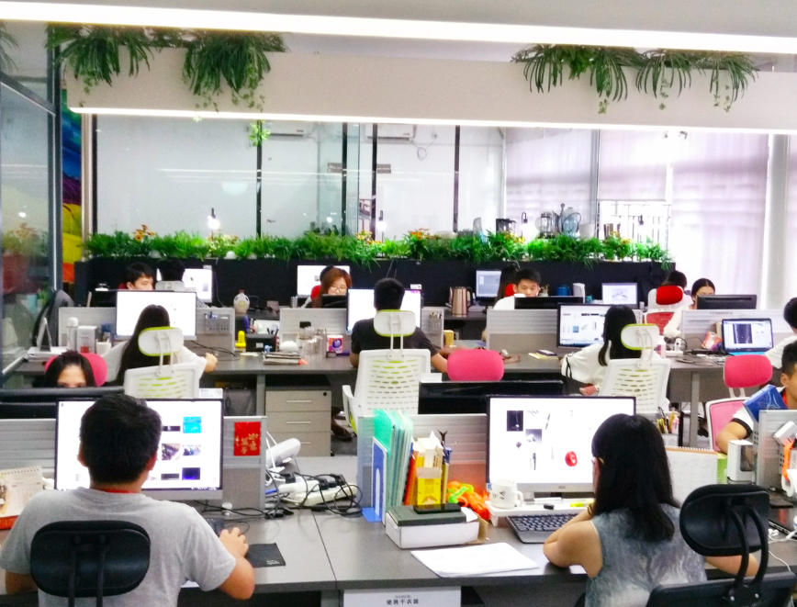
Office environment
Office in GIDC

Slide 5
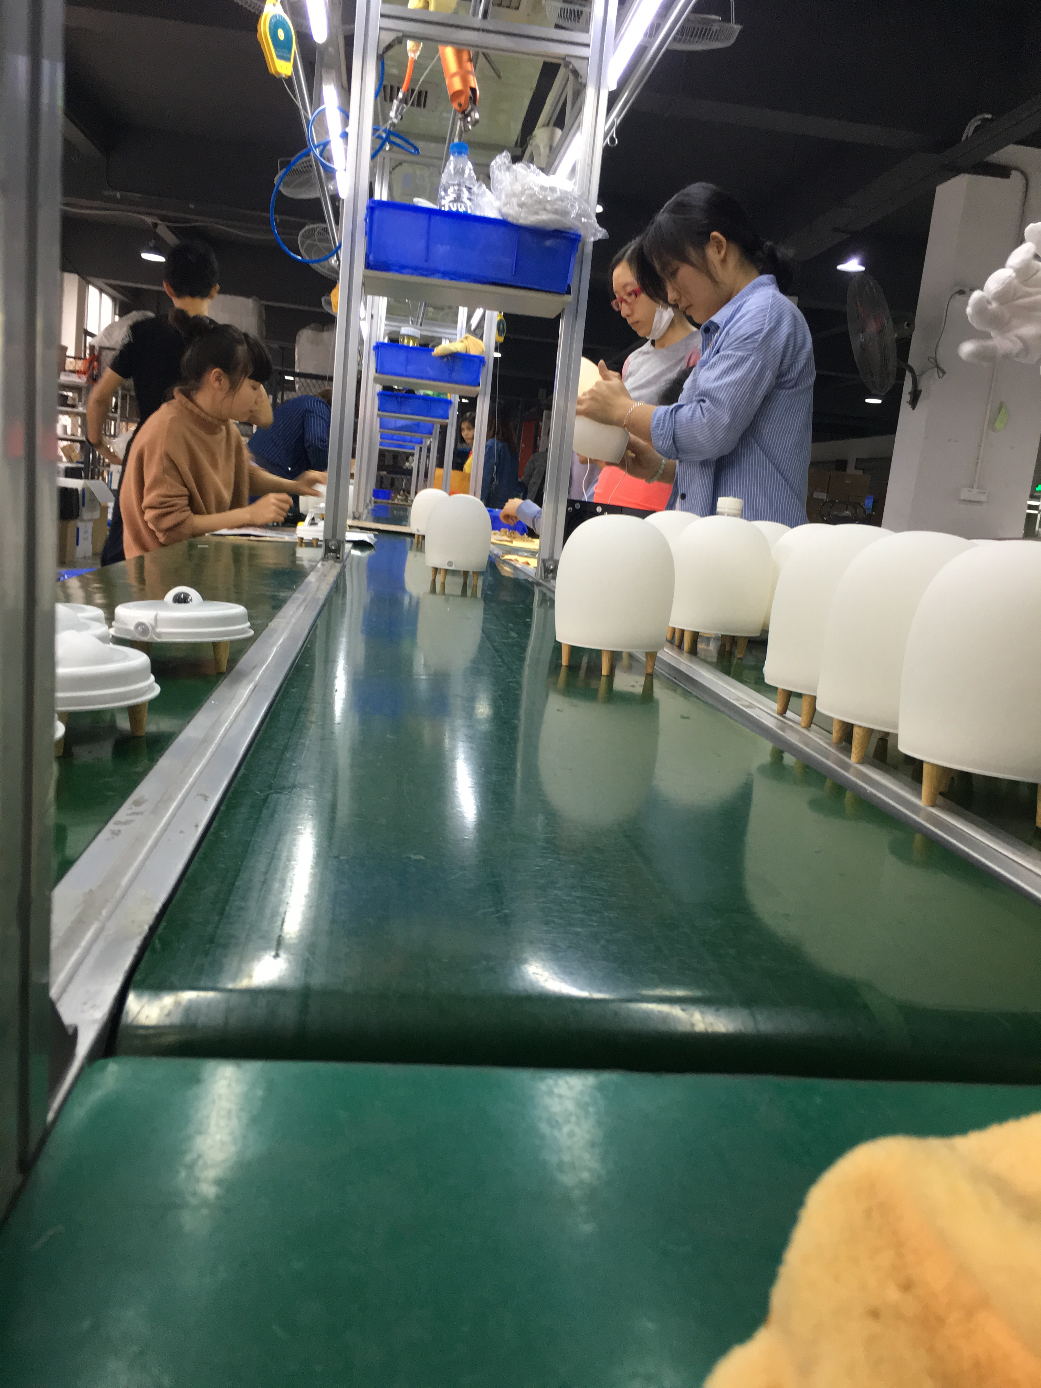
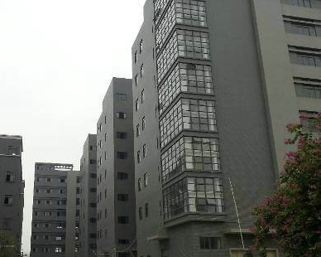
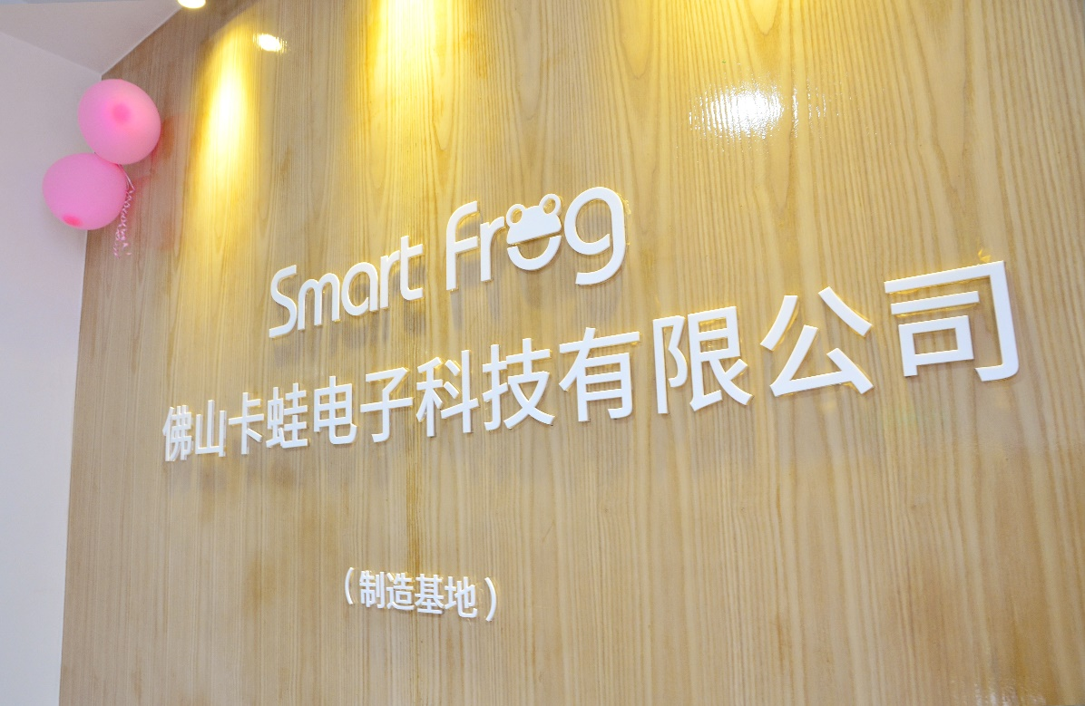
Office environment
Manufacturing Base
Worker: 120人，The manufacturing base set up the plans, procurement,production,quality assurance,logistics and other functional departments.And we are the implementation of digital management, it provides a strong support for our company to carry out the hign-quality concept.

Slide 6
我们的团队 Our team
Staff constitute
Master degree candidate
University degree
special school
over 10 years
between 5-10 years
between 1-5 years
professor
senior designer
The proportion of the management personnel's educational structure.
Personnel work experience structure proportion.
The proportion of the design capability hierarchy.

Slide 7
Our advantage

Slide 8
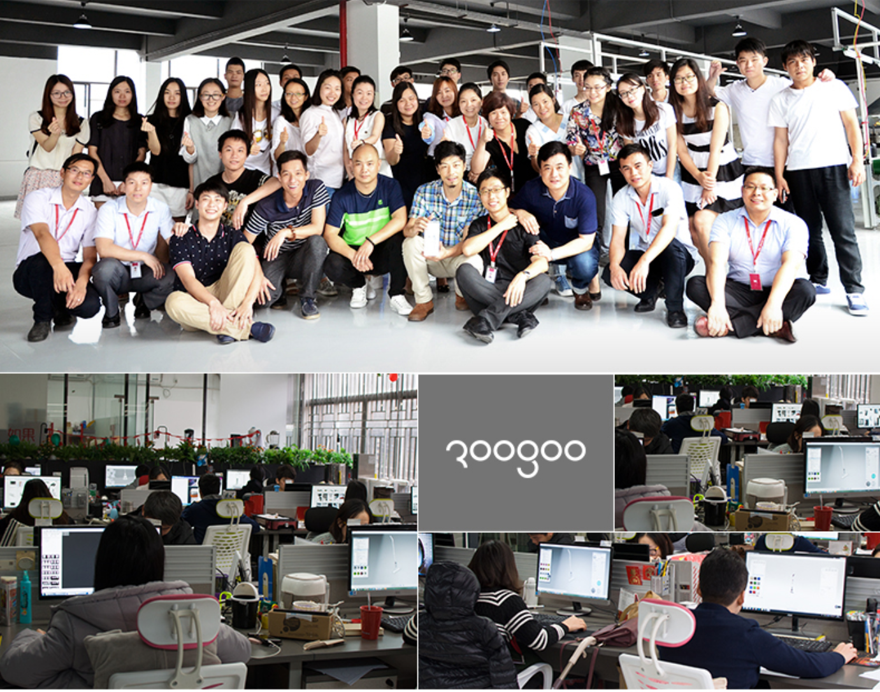
我们的优势 Our advantage
Roogoo creative design team,formerly known as industrial design company,we have rich experience in the product innovation and design. And we constantly output non-homogeneousness hot style products.
市场调研 消费者研究 需求分析 创意设计
材质材料 结构与工艺 创新功能 包装语言
market research
consumer research
demand analysis
creative design
material
Structure and technology
creative funcion
packaging language
more than senior creative designer
11 years of design experience
Experiencing more than 1000 special cases

Slide 9
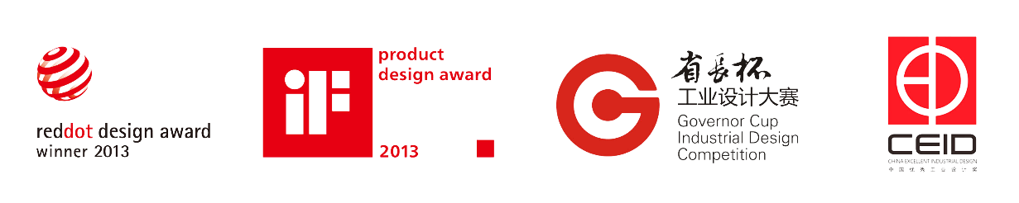



我们的优势 Our advantage
Our achievement in design
Our team had won a lot of awards in the domestic and overseas ，
creativity obtained the general customers consistent approval and praise

Slide 10
我们的优势 Our advantage
The method of creative in product OEDO
Original(原始创意)
Experience(感同身受)
Design(设计创新)
Optimize(优化改善)
原创从生活中来，产品到生活中去
(Originality comes from life,products into our life.)
Roogoo innovate not only rely on gift and inspiration,
but also has sentific and creative method to direct the product position and direction.

Slide 11
我们的优势 Our advantage
R&D Strength
Formalized and standardized design ensure high efficiency
More than 10 new products are planned for one year.
R&D staff structure：100% Under-graduate
or above.
New product evaluation、trial production and development process to ensure high stability.
Big data、listen to the market and continully update product to ensure optimization.
Professors :
senior engineer :
medium engineer:

Slide 12
我们的优势 Our advantage
Manufacturing Capability
The factory area is
3000 square meters
The warehouse area is
1000 square meters.
There are 100 staffs
in the factory
It is expected to produce
5 million units annually
The average class produces
15000 units per day
There are 5 production
lines

Slide 13
THANK YOU

